Slide 1

6th Grade Math
Unit 7, Lesson 9 Integer Subtraction Volume 2, pg. 43

Slide 2


Benchmark
MA.6.NSO.4.1
Apply and extend previous understandings of operations with whole numbers to add and subtract integers with procedural fluency.
volume 2, pg. 43

Slide 3
Integrated Mathematical Thinking and Reasoning Standards
MA.K12.MTR.4.1 Engage in discussions that reflect on the mathematical thinking of self and others.
MA.K12.MTR.5.1 Use patterns and structure to help understand and connect mathematical concepts.
volume 2, pg. 43

Slide 4


Learning Target
I can subtract integers with values greater than $100$.
volume 2, pg. 43

Slide 5

Warm-Up
volume 2, pg. 43

Slide 6
7.9.1 Warm-Up: Self-Reflection
For each statement, rate yourself on a scale of 1-5. A rating of 5 means “absolutely yes” and 1 means “absolutely not.”
Statement | Rating
I can subtract integers using integer chips.
I understand how to show subtraction of integers on the number line.
I can subtract integers without using integer chips or a number line.
I can explain to someone else how to subtract integers.
volume 2, pg. 43

Slide 7

Guided Practice
volume 2, pg. 44

Slide 8

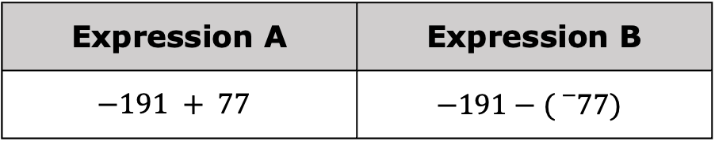
7.9.2 Guided Practice: Subtracting Integers
Two expressions are shown.
Expression A | Expression B
$$−191 + 77$$ | $$−191−({}_{}^{−}{77)}$$
With your partner, determine if the expressions are equivalent. Summarize your determination below.
volume 2, pg. 44

Slide 9
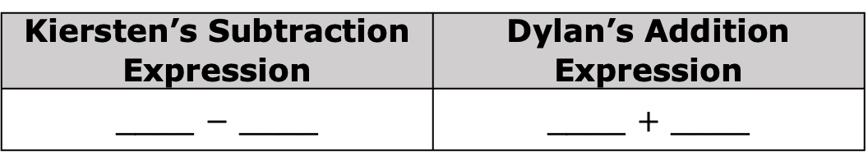
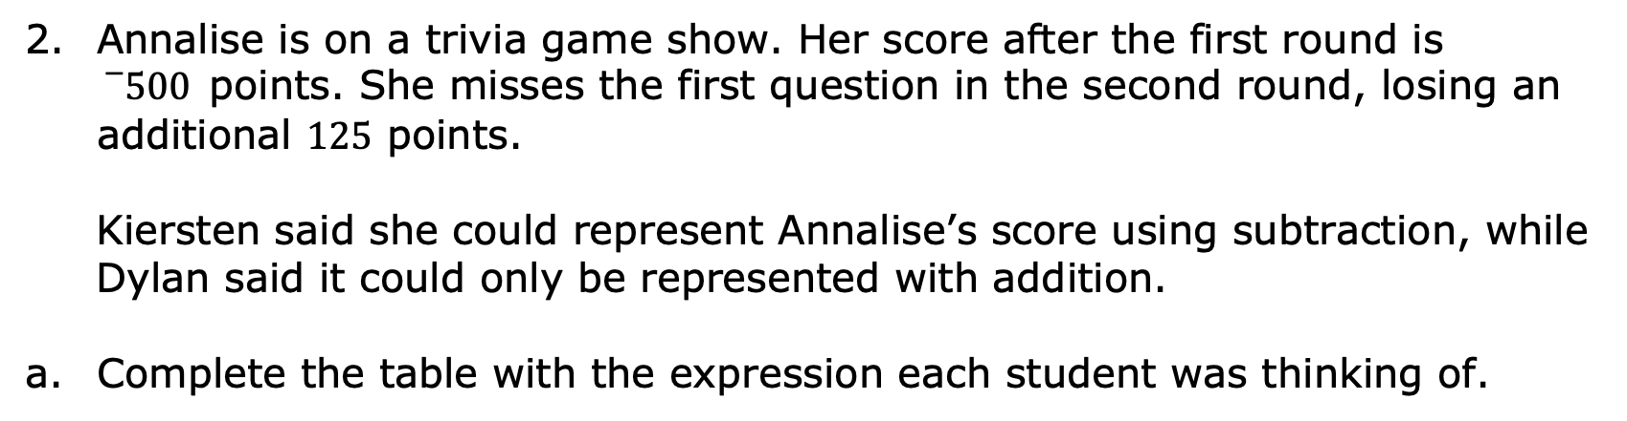
Annalise is on a trivia game show. Her score after the first round is ${}_{}^{−}{500}$points. She misses the first question in the second round, losing an additional $125$ points.
Kiersten said she could represent Annalise’s score using subtraction, while Dylan said it could only be represented with addition.
Complete the table with the expression each student was thinking of.
Kiersten’s Subtraction Expression | Dylan’s Addition Expression
____ $−$ ____ | ____ $+$ ____
volume 2, pg. 44

Slide 10
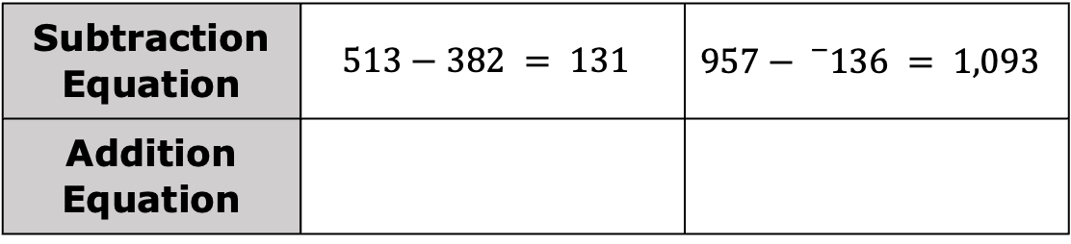
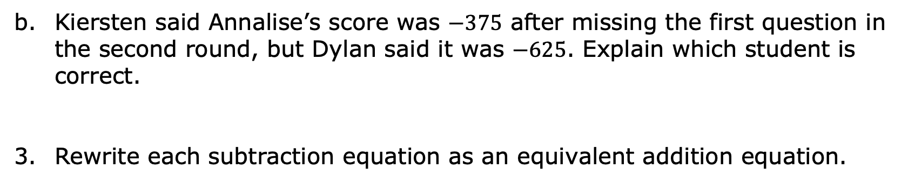
Kiersten said Annalise’s score was $−375$ after missing the first question in the second round, but Dylan said it was $−625$. Explain which student is correct.
Rewrite each subtraction equation as an equivalent addition equation.
Subtraction Equation | $$513−382 = 131$$ | $$957−{}_{}^{−}{136} = 1,093$$
Addition Equation
volume 2, pg. 44

Slide 11

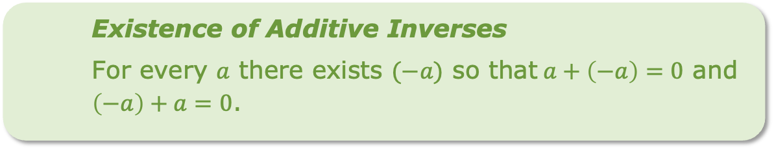
Addition and subtraction are inverse operations, which means they are operations that have the opposite effect of each other.
Understanding this relationship and the existence of additive inverses can be helpful when subtracting integers.
Existence of Additive Inverses
For every $a$ there exists $(−a)$ so that$a+\left(−a\right)=0$ and $\left(−a\right)+a=0$.
volume 2, pg. 44

Slide 12
Complete the statements below using this information.
A subtraction expression can be rewritten as an equivalent addition expression by changing the operation from subtraction to ________________ and changing the second value to its _____________ _____________.
volume 2, pg. 44

Slide 13

Try It
volume 2, pg. 45

Slide 14

7.9.3 Try It: Subtracting Integers
The table shows the beginning and ending elevations, in feet (ft), of six different hiking trails. The change in elevation along the trail can be found by subtracting the initial elevation from the final elevation.
(𝑓𝑖𝑛𝑎𝑙 𝑒𝑙𝑒𝑣𝑎𝑡𝑖𝑜𝑛) − (𝑖𝑛𝑖𝑡𝑖𝑎𝑙 𝑒𝑙𝑒𝑣𝑎𝑡𝑖𝑜𝑛) = (𝑐ℎ𝑎𝑛𝑔𝑒 𝑖𝑛 𝑒𝑙𝑒𝑣𝑎𝑡𝑖𝑜𝑛)
volume 2, pg. 45

Slide 15
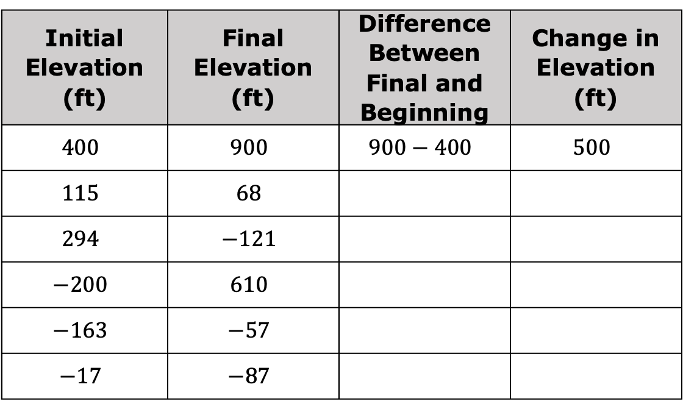
Write an expression that represents the change in elevation along each hiking trail. Then, write the value that represents the change in elevation.
The first row has been completed as an example.
Initial Elevation (ft) | Final Elevation (ft) | Difference Between Final and Beginning | Change in Elevation (ft)
$$400$$ | $$900$$ | $$900−400$$ | $$500$$
$$115$$ | $$68$$
$$294$$ | $$−121$$
$$−200$$ | $$610$$
$$−163$$ | $$−57$$
$$−17$$ | $$−87$$
volume 2, pg. 45

Slide 16
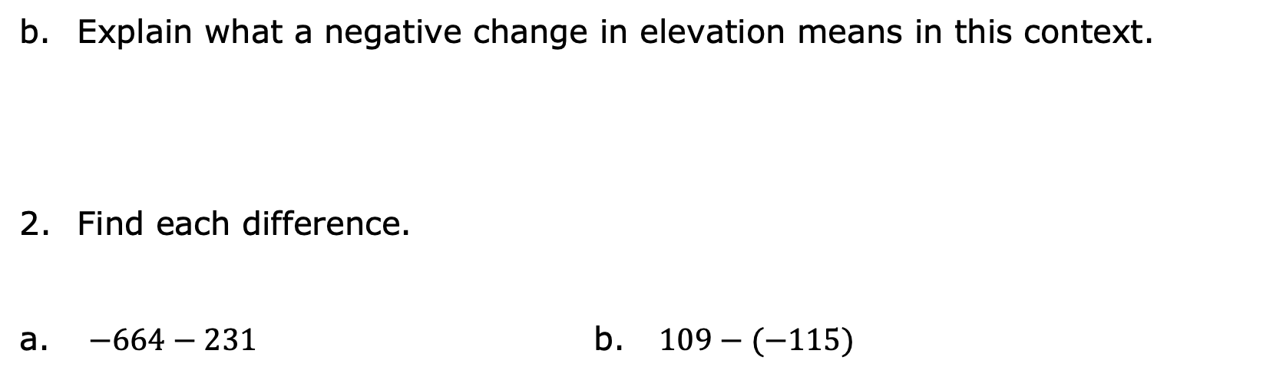
Explain what a negative change in elevation means in this context.
Find each difference.
$−664−231$ b. $109−(−115)$
volume 2, pg. 45

Slide 17

Your Turn
volume 2, pg. 46

Slide 18

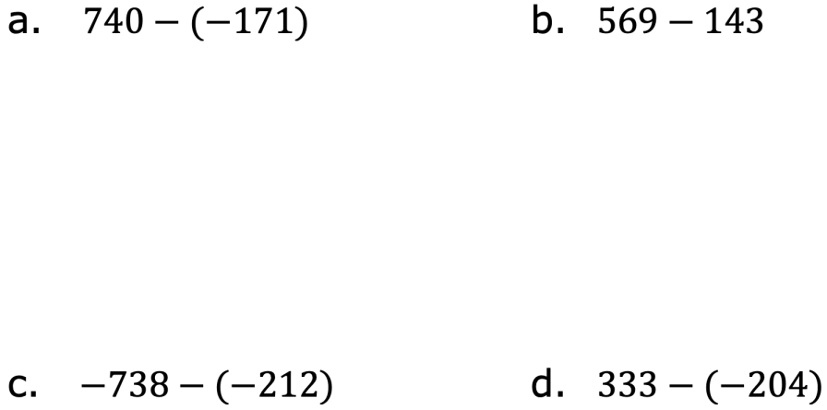
7.9.4 Your Turn!
Evaluate each expression.
volume 2, pg. 46

Slide 19
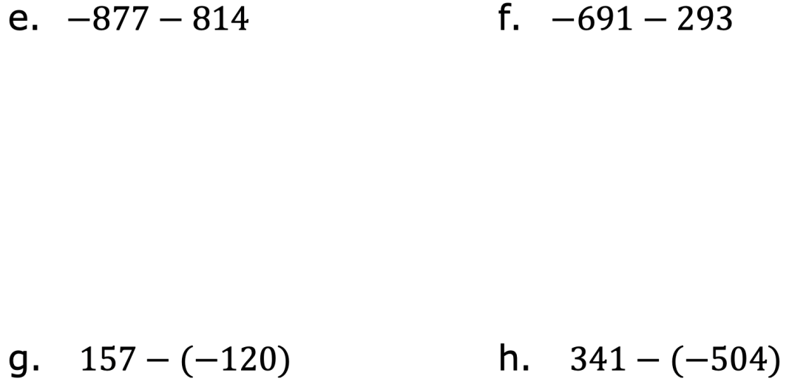
volume 2, pg. 46

Slide 20

Wrap-Up
volume 2, pg. 46

Slide 21

7.9.5 Wrap-Up: Ticket Out the Door
Evaluate each expression.
$447−(−702)$ b. $−834−(−610)$
$−309−525$
volume 2, pg. 46

